Slide 1
Recursion
Creative Commons Attribution-NonCommercial-ShareAlike 3.0 Unported License. http://creativecommons.org/licenses/by-nc-sa/3.0/
Written by Rachel J. Morris, last updated 2016-04-10

Slide 2
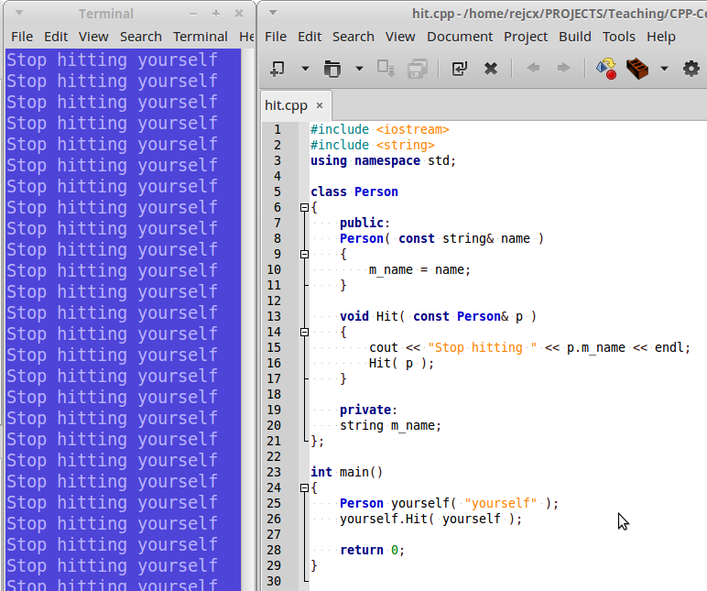
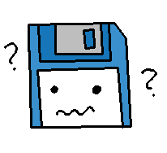
Learning to think recursively

Slide 3
Recursion
Recursion, generally, is when a function calls itself.
The main idea behind this is that a problem can be solved with the same logic, and by splitting the problem into smaller bits.
Recursion is used a lot with searching and sorting algorithms.

Slide 4
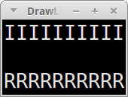
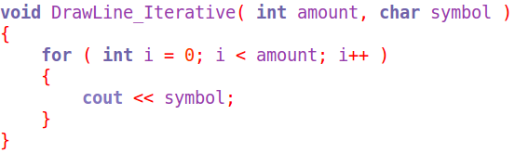
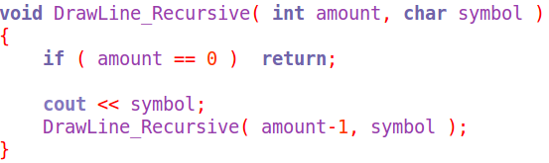
Recursion
Iterative
Sometimes, we can implement something as a simple loop...
Recursive
...or as a recursive function,
with relative ease.
However, sometimes a recursive function makes for the simplest implementation

Slide 5
Recursion
Recursive
When creating a function that will call itself, we need to make sure to include a
Base case (aka stopping case)
so the function does not loop forever.
But if that base case is not hit, we will do the process over again, and call the function with new parameters.

Slide 6
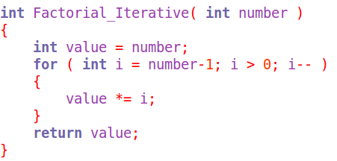
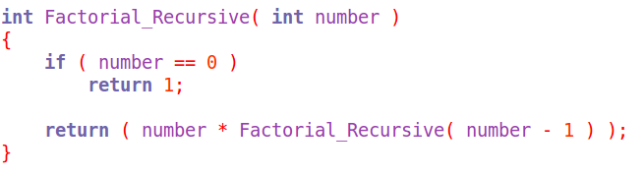
Recursion
Iterative
A recursive function can be void, or it can return a value.
It can take some work to think in terms of “recursion” instead of “iteration”.
Recursive
Build your function a step at a time, and test after each addition.

Slide 7
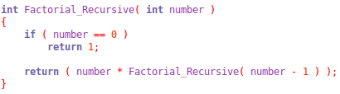
Recursion
Let's step through the execution of this function...
Initial call:
Factorial_Recursive( 5 );
Number isn't 0, so multiply 5 by the result of Factorial_Recursive( 4 )

Slide 8
Recursion
Let's step through the execution of this function...
Initial call:
Factorial_Recursive( 5 );
Number isn't 0, so multiply 5 by the result of Factorial_Recursive( 4 )
Call #2:
Factorial_Recursive( 4 );
Number isn't 0, so multiply 4 by the result of Factorial_Recursive( 3 )

Slide 9
Recursion
Let's step through the execution of this function...
Initial call:
Factorial_Recursive( 5 );
Number isn't 0, so multiply 5 by the result of Factorial_Recursive( 4 )
Call #2:
Factorial_Recursive( 4 );
Number isn't 0, so multiply 4 by the result of Factorial_Recursive( 3 )
Call #3:
Factorial_Recursive( 3 );
Number isn't 0, so multiply 3 by the result of Factorial_Recursive( 2 )

Slide 10
Recursion
Let's step through the execution of this function...
Initial call:
Factorial_Recursive( 5 );
Number isn't 0, so multiply 5 by the result of Factorial_Recursive( 4 )
Call #2:
Factorial_Recursive( 4 );
Number isn't 0, so multiply 4 by the result of Factorial_Recursive( 3 )
Call #3:
Factorial_Recursive( 3 );
Number isn't 0, so multiply 3 by the result of Factorial_Recursive( 2 )
Call #4:
Factorial_Recursive( 2 );
Number isn't 0, so multiply 2 by the result of Factorial_Recursive( 1 )
Call #5:
Factorial_Recursive( 1 );
Number isn't 0, so multiply 1 by the result of Factorial_Recursive( 0 )

Slide 11
Recursion
Let's step through the execution of this function...
Initial call:
Factorial_Recursive( 5 );
Number isn't 0, so multiply 5 by the result of Factorial_Recursive( 4 )
Call #2:
Factorial_Recursive( 4 );
Number isn't 0, so multiply 4 by the result of Factorial_Recursive( 3 )
Call #3:
Factorial_Recursive( 3 );
Number isn't 0, so multiply 3 by the result of Factorial_Recursive( 2 )
Call #4:
Factorial_Recursive( 2 );
Number isn't 0, so multiply 2 by the result of Factorial_Recursive( 1 )

Slide 12
Recursion
Let's step through the execution of this function...
Initial call:
Factorial_Recursive( 5 );
Number isn't 0, so multiply 5 by the result of Factorial_Recursive( 4 )
Call #2:
Factorial_Recursive( 4 );
Number isn't 0, so multiply 4 by the result of Factorial_Recursive( 3 )
Call #3:
Factorial_Recursive( 3 );
Number isn't 0, so multiply 3 by the result of Factorial_Recursive( 2 )
Call #4:
Factorial_Recursive( 2 );
Number isn't 0, so multiply 2 by the result of Factorial_Recursive( 1 )
Call #5:
Factorial_Recursive( 1 );
Number isn't 0, so multiply 1 by the result of Factorial_Recursive( 0 )
Call #6:
Factorial_Recursive( 0 );
Number is 0, so return 1

Slide 13
Recursion
Let's step through the execution of this function...
Initial call:
Factorial_Recursive( 5 );
Number isn't 0, so multiply 5 by the result of Factorial_Recursive( 4 )
Call #2:
Factorial_Recursive( 4 );
Number isn't 0, so multiply 4 by the result of Factorial_Recursive( 3 )
Call #3:
Factorial_Recursive( 3 );
Number isn't 0, so multiply 3 by the result of Factorial_Recursive( 2 )
Call #4:
Factorial_Recursive( 2 );
Number isn't 0, so multiply 2 by the result of Factorial_Recursive( 1 )
Call #5:
Factorial_Recursive( 1 );
Number isn't 0, so multiply 1 by the result of Factorial_Recursive( 0 )
Call #6:
Factorial_Recursive( 0 );
Number is 0, so return 1
1

Slide 14
Recursion
Let's step through the execution of this function...
Initial call:
Factorial_Recursive( 5 );
Number isn't 0, so multiply 5 by the result of Factorial_Recursive( 4 )
Call #2:
Factorial_Recursive( 4 );
Number isn't 0, so multiply 4 by the result of Factorial_Recursive( 3 )
Call #3:
Factorial_Recursive( 3 );
Number isn't 0, so multiply 3 by the result of Factorial_Recursive( 2 )
Call #4:
Factorial_Recursive( 2 );
Number isn't 0, so multiply 2 by the result of Factorial_Recursive( 1 )
Call #5:
Factorial_Recursive( 1 );
Number isn't 0, so multiply 1 by the result of Factorial_Recursive( 0 )
1 *
1
Call #6:
Factorial_Recursive( 0 );
Number is 0, so return 1
1

Slide 15
Recursion
Let's step through the execution of this function...
Initial call:
Factorial_Recursive( 5 );
Number isn't 0, so multiply 5 by the result of Factorial_Recursive( 4 )
Call #2:
Factorial_Recursive( 4 );
Number isn't 0, so multiply 4 by the result of Factorial_Recursive( 3 )
Call #3:
Factorial_Recursive( 3 );
Number isn't 0, so multiply 3 by the result of Factorial_Recursive( 2 )
Call #4:
Factorial_Recursive( 2 );
Number isn't 0, so multiply 2 by the result of Factorial_Recursive( 1 )
2 *
1 *
1
Call #5:
Factorial_Recursive( 1 );
Number isn't 0, so multiply 1 by the result of Factorial_Recursive( 0 )
1 *
1
Call #6:
Factorial_Recursive( 0 );
Number is 0, so return 1
1

Slide 16
Recursion
Let's step through the execution of this function...
Initial call:
Factorial_Recursive( 5 );
Number isn't 0, so multiply 5 by the result of Factorial_Recursive( 4 )
Call #2:
Factorial_Recursive( 4 );
Number isn't 0, so multiply 4 by the result of Factorial_Recursive( 3 )
Call #3:
Factorial_Recursive( 3 );
Number isn't 0, so multiply 3 by the result of Factorial_Recursive( 2 )
3 *
2 *
1 *
1
Call #4:
Factorial_Recursive( 2 );
Number isn't 0, so multiply 2 by the result of Factorial_Recursive( 1 )
2 *
1 *
1
Call #5:
Factorial_Recursive( 1 );
Number isn't 0, so multiply 1 by the result of Factorial_Recursive( 0 )
1 *
1
Call #6:
Factorial_Recursive( 0 );
Number is 0, so return 1
1

Slide 17
Recursion
Let's step through the execution of this function...
Initial call:
Factorial_Recursive( 5 );
Number isn't 0, so multiply 5 by the result of Factorial_Recursive( 4 )
Call #2:
Factorial_Recursive( 4 );
Number isn't 0, so multiply 4 by the result of Factorial_Recursive( 3 )
4 *
3 *
2 *
1 *
1
Call #3:
Factorial_Recursive( 3 );
Number isn't 0, so multiply 3 by the result of Factorial_Recursive( 2 )
3 *
2 *
1 *
1
Call #4:
Factorial_Recursive( 2 );
Number isn't 0, so multiply 2 by the result of Factorial_Recursive( 1 )
2 *
1 *
1
Call #5:
Factorial_Recursive( 1 );
Number isn't 0, so multiply 1 by the result of Factorial_Recursive( 0 )
1 *
1
Call #6:
Factorial_Recursive( 0 );
Number is 0, so return 1
1

Slide 18
Recursion
Let's step through the execution of this function...
Initial call:
Factorial_Recursive( 5 );
Number isn't 0, so multiply 5 by the result of Factorial_Recursive( 4 )
5 *
4 *
3 *
2 *
1 *
1
Call #2:
Factorial_Recursive( 4 );
Number isn't 0, so multiply 4 by the result of Factorial_Recursive( 3 )
4 *
3 *
2 *
1 *
1
Call #3:
Factorial_Recursive( 3 );
Number isn't 0, so multiply 3 by the result of Factorial_Recursive( 2 )
3 *
2 *
1 *
1
Call #4:
Factorial_Recursive( 2 );
Number isn't 0, so multiply 2 by the result of Factorial_Recursive( 1 )
2 *
1 *
1
Call #5:
Factorial_Recursive( 1 );
Number isn't 0, so multiply 1 by the result of Factorial_Recursive( 0 )
1 *
1
Call #6:
Factorial_Recursive( 0 );
Number is 0, so return 1
1

Slide 19
Recursion
Let's step through the execution of this function...
120
Initial call:
Factorial_Recursive( 5 );
Number isn't 0, so multiply 5 by the result of Factorial_Recursive( 4 )
5 *
4 *
3 *
2 *
1 *
1
Call #2:
Factorial_Recursive( 4 );
Number isn't 0, so multiply 4 by the result of Factorial_Recursive( 3 )
4 *
3 *
2 *
1 *
1
Call #3:
Factorial_Recursive( 3 );
Number isn't 0, so multiply 3 by the result of Factorial_Recursive( 2 )
3 *
2 *
1 *
1
Call #4:
Factorial_Recursive( 2 );
Number isn't 0, so multiply 2 by the result of Factorial_Recursive( 1 )
2 *
1 *
1
Call #5:
Factorial_Recursive( 1 );
Number isn't 0, so multiply 1 by the result of Factorial_Recursive( 0 )
1 *
1
Call #6:
Factorial_Recursive( 0 );
Number is 0, so return 1
1

Slide 20
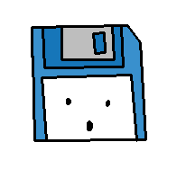
Recursion
That was a simple example, but as functions that use recursion get more complex, it might still help to step through and write down variable values at each step.
Where does recursion really come in handy?

Slide 21

Recursion
Data.
Sorting,
Building data structures
Searching,
5
3
10
2
7
13
-2

Slide 22
Recursion
Here are some practice problems to work on...

Slide 23
Practice
1
Write a recursive function that can be used to generate a Fibonacci sequence, up to some length specified by the user.
2
Write a recursive function that can be used to compute the value of
X^{n} , by multiplying X by itself n amount of times.
3
Write a recursive function that will reverse a string,
so the first letter is last and vice versa, through the entire string.

